Slide 1


Welcome to a CZU Fire Area Community Meeting
Rebuilding Topic:
Septic and Water Systems
May 4, 2021

Slide 2
RECOVERY PERMIT CENTER
701 Ocean Street
Community Room
Santa Cruz, CA 95060
Please contact us!
To make an appointment (required)
Visit: rpcappt@timetap.com
Call: (831) 454-5323
Email: rpc@santacruzcounty.us
Hours of Operation
Monday - Friday
8AM – 12PM, 1PM – 5PM

Slide 3
RECOVERY PERMIT CENTER
PRIMARY CONTACTS
Mike Renner, CBO
(925) 785-3581
mrenner@4leafinc.com
Marcus Johnson
(925) 785-3315
mjohnson@4leafinc.com

Slide 4
MEETING PROTOCOL
This meeting will be recorded, and the chat will be preserved.
We will mute everyone to prevent background noise.
Hold questions until after the presentation, as many things may be answered as we go through the presentation.
For questions, if you are on a computer, please type your question in the chat function OR use the raise hand function so someone can call on you. We will ask you to unmute when you are called on.
Be respectful, don’t interrupt others, ask only one question at a time so others can ask as well.
After the meeting questions can be asked at the Recovery Permit Center or by emailing http://www.co.santa-cruz.ca.us/FireRecovery/AsktheRecoveryTeam.aspx

Slide 5
AGENDA
Purpose and Introductions
Regulations that apply
  ADUs
Environmental Health Pre-Clearance
Septic Site Evaluations
LAMP
Permits
Questions and Responses
a

Slide 6
Purpose
Present septic system basics: the” why” and ”what” of the regulations, and how septic systems work
Describe the path to obtaining an Environmental Health Pre-Clearance (on the way to a building permit)
Respond to your questions and concerns
Introductions
Paia Levine
Dr. Marilyn Underwood
Marcus Johnson

Slide 7
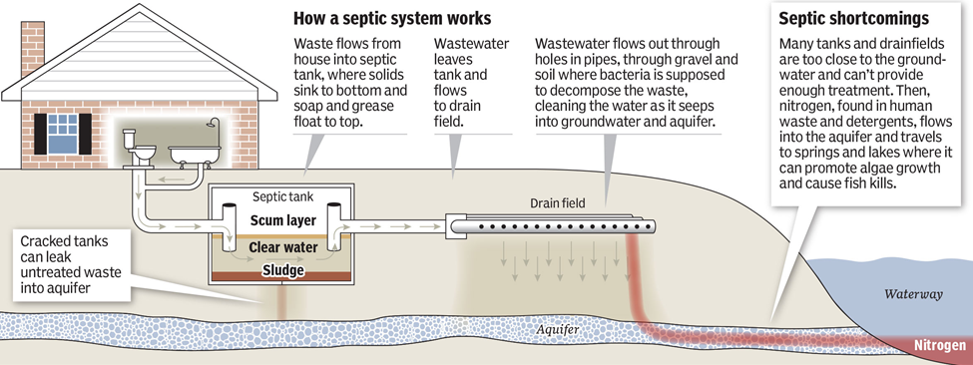
Most homes in the CZU burn area have a septic system to treat wastewater. Most homes also have wells for drinking water.
If a septic system is not working properly or is too close to the drinking water source or a creek or waterway, the wastewater may contaminate the drinking water supply or the creek.
About half the burn area creeks drain to the San Lorenzo River, a major source of drinking water for the community.
Septic Systems and the Environment

Slide 8
Design Standards for Rebuilding are in the Santa
Cruz County Code and State Regulations
Summary:
7.38.080 (A-D) Existing system—Building alterations.
(B) A one-time addition to any legal residential structure of up to 500 square feet with no increase in bedrooms may be approved to the existing sewage disposal system. Provided that:
  New square footage does not encroach on the existing system or expansion area.
  The existing system is in functioning without failure.
  There is adequate information on the location, construction and function of the existing system.
  Legal structures that meet the requirements of this section do not need to meet the minimum lot size provision.

Slide 9
7.38.080 Existing system—Building alterations. (Cont.)
(C) Reconstruction of Occupied Structures Destroyed by Fire or Calamity.
  Legal structure for residential or commercial use, constructed with a building permit or prior to the requirement for building permits.
  Sewage disposal system to serve the rebuild shall be upgraded to meet current standards, or demonstration the existing system meets standards and is in functional condition.
  Combine any contiguous undeveloped lots to achieve a minimum parcel size of 15,000 square feet.
(D) Any proposed new use or proposed expansion of an existing use can only be approved if all existing and proposed uses on the parcel can be served by a sewage disposal system that meets the requirements for a standard system or alternative system.

Slide 10
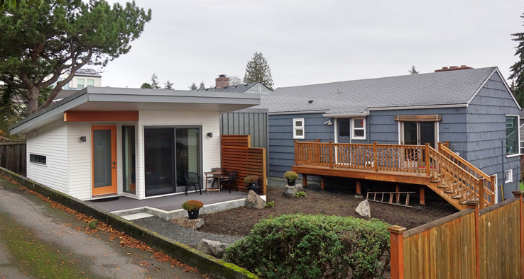
ADU Septic System
Adding a new ADU means that a sewage disposal system that can accommodate the wastewater load from the ADU must be installed.
A 1500-gallon tank for the ADU is required
The ADU leaching is calculated with the bedroom counts plus additional from the kitchen, laundry, etc.
  Properties larger than 2 acres can install a second sewage disposal system to accommodate the ADU
  Properties smaller than 2 acres will need to account for leaching that will cover both the main house and ADU. This will also be required 100% expansion.

Slide 11
ADU Septic System
Phasing your project can provide flexibility to construct the ADU first or after the main home is rebuilt.
Building the ADU first
  Connecting to the permitted existing system can be accommodated.
    Preplanning and setting up phased construction to have the most success.
Building the Main home then an ADU
  Will outline the normal process to have a sewage disposal system at issuance of building permits.
Building the Main home and ADU at the same time
  Properties larger than 2 acres can install a second sewage disposal system to accommodate the ADU
  Properties smaller than 2 acres will need to account for leaching that will cover both the main house and ADU. 100% expansion will also be required.

Slide 12
Environmental Health Pre-Clearance
The Environmental Health Pre-Clearance addresses:
whether the sewage disposal system is properly sized for rebuilding “in kind”;
determines any system requirements when rebuilding larger or adding uses (such as a new ADU) to the property;
checks the permit history of the system and the record of how the system is functioning;
confirms setbacks are met for groundwater, distances to creeks, wells, etc.

Slide 13
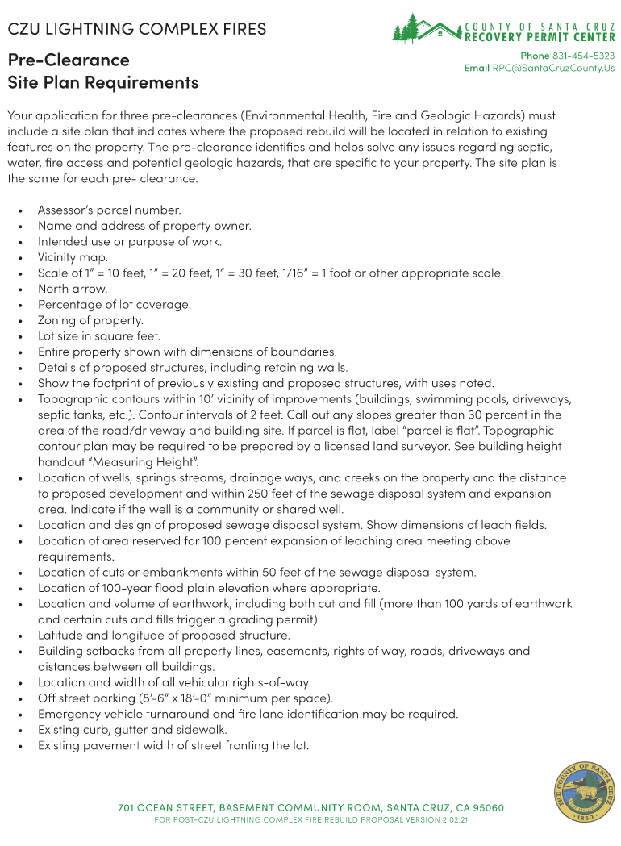
Environmental Health
Pre-Clearance
Site plan guidance is found on the website:
https://www.santacruzcounty/FireRecovery/

Slide 14
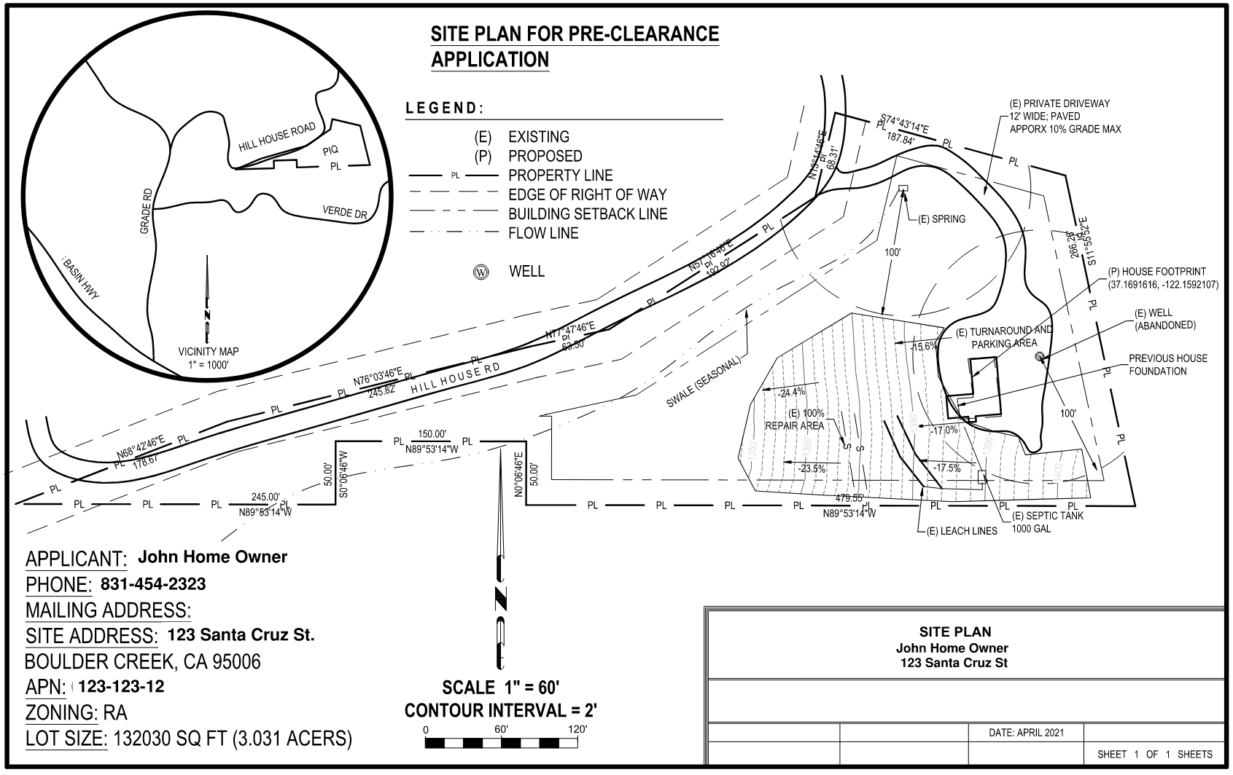
Environmental Health Pre-Clearance

Slide 15
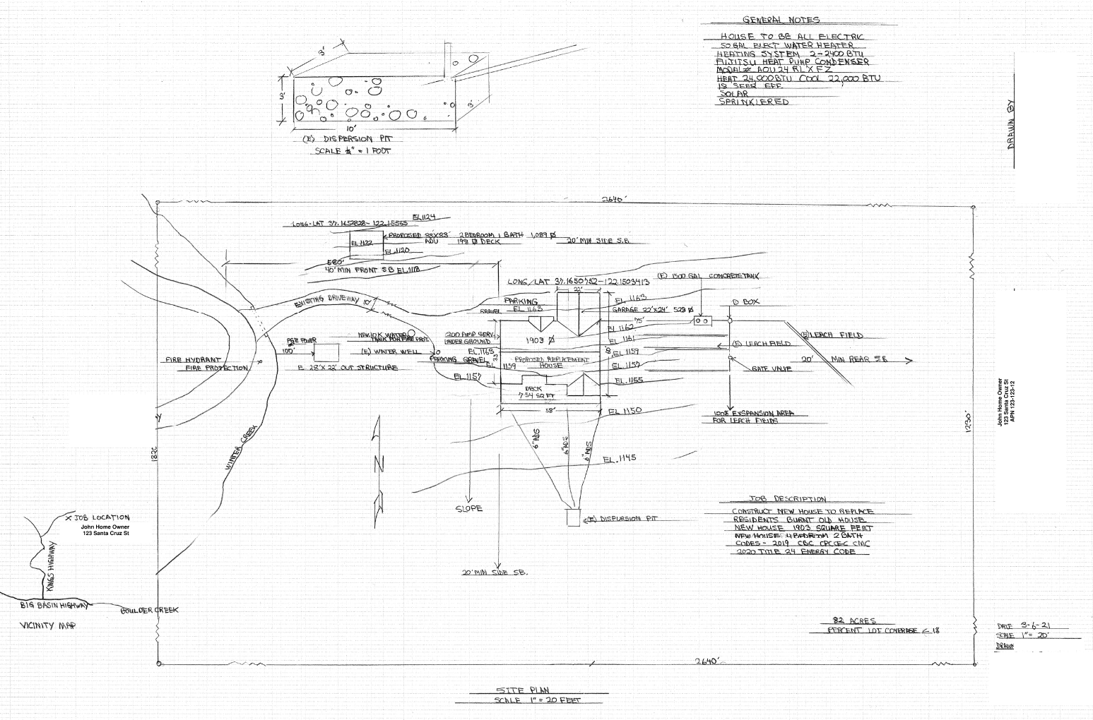
Environmental Health Pre-Clearance

Slide 16
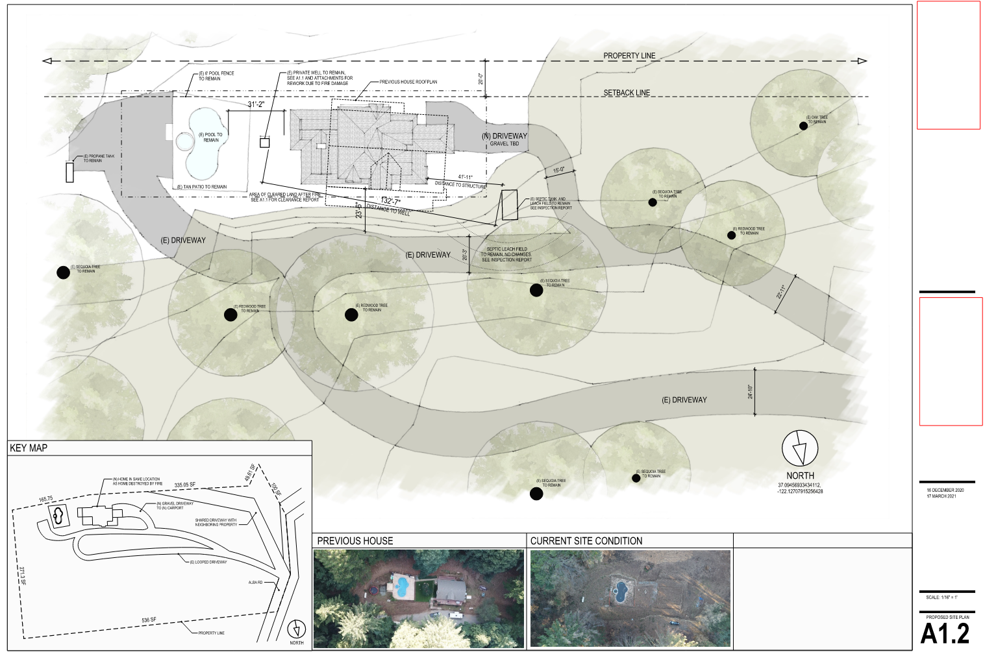
Pre-Clearance Environmental Health Review

Slide 17
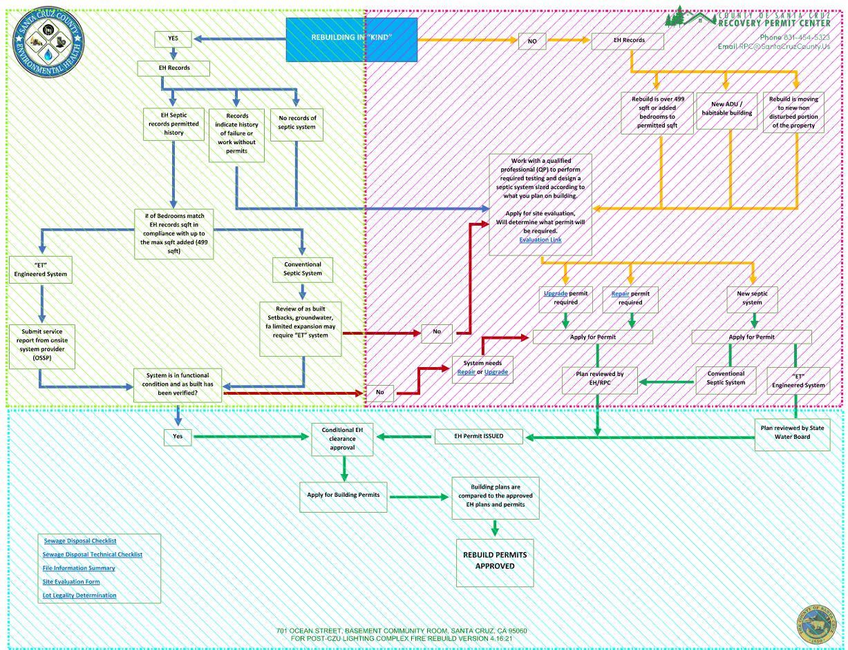

Slide 18
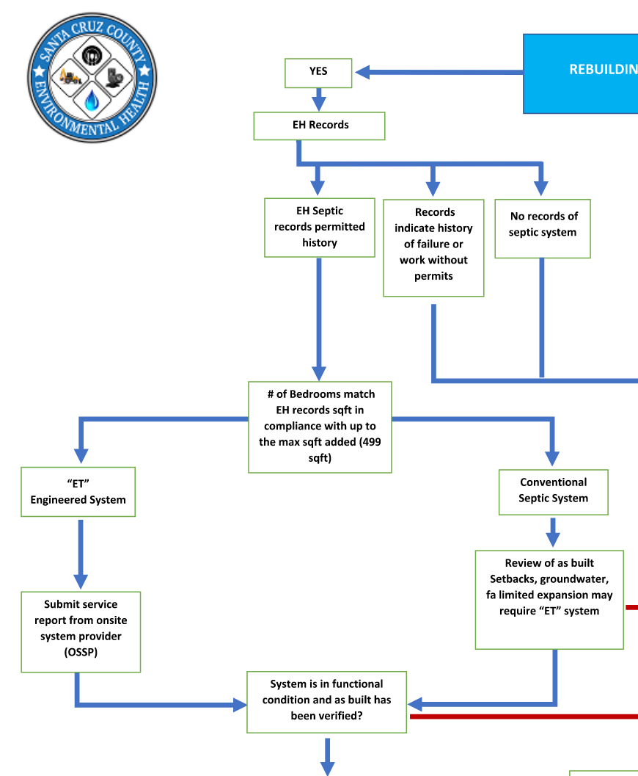
Pre-Clearance Results

Slide 19
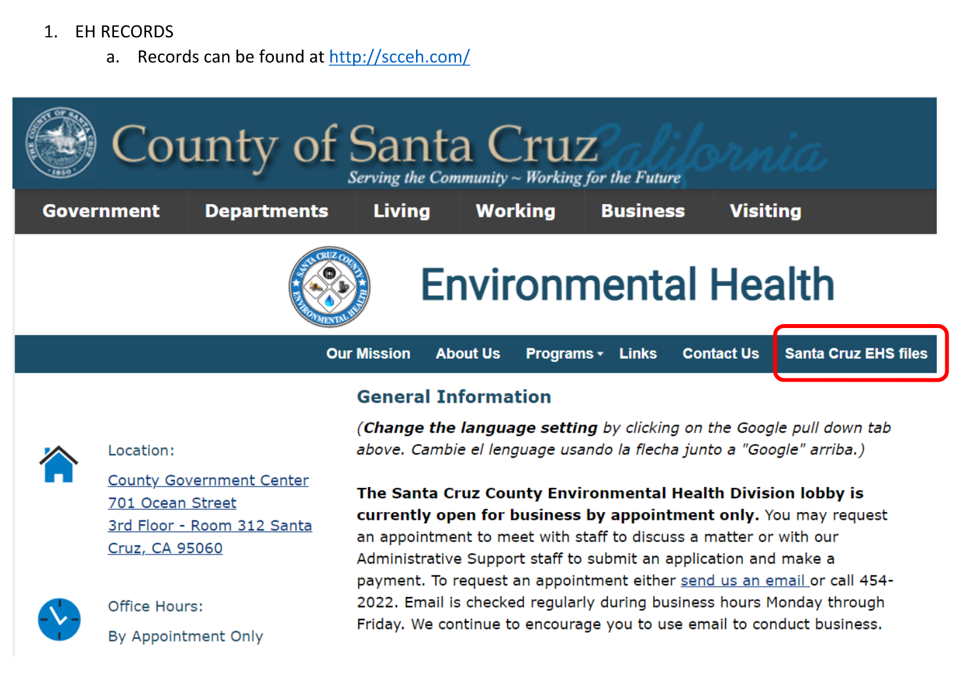
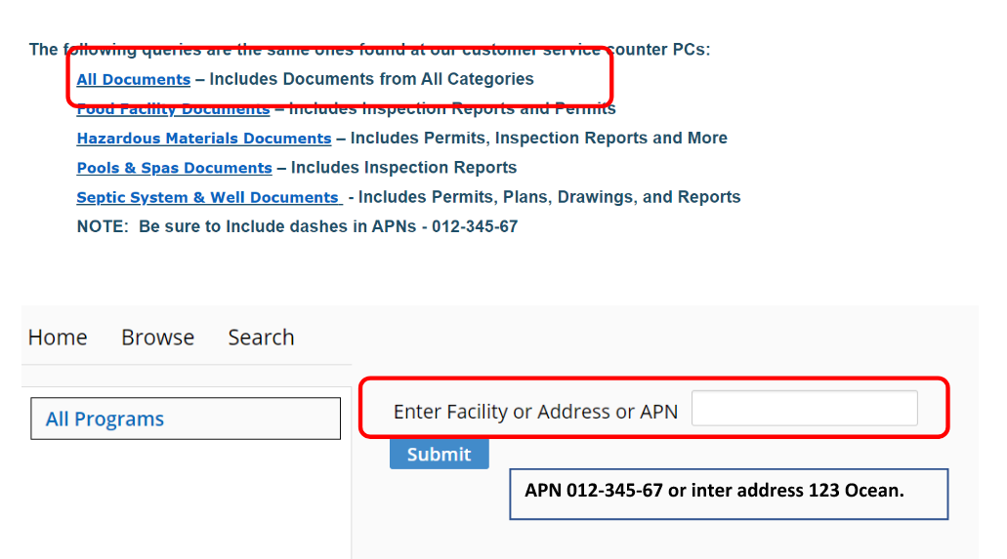
Pre-Clearance Results

Slide 20
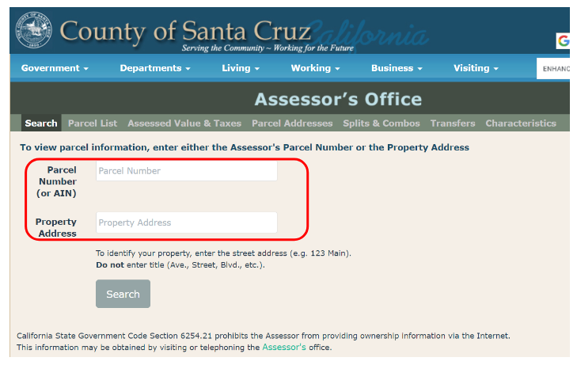
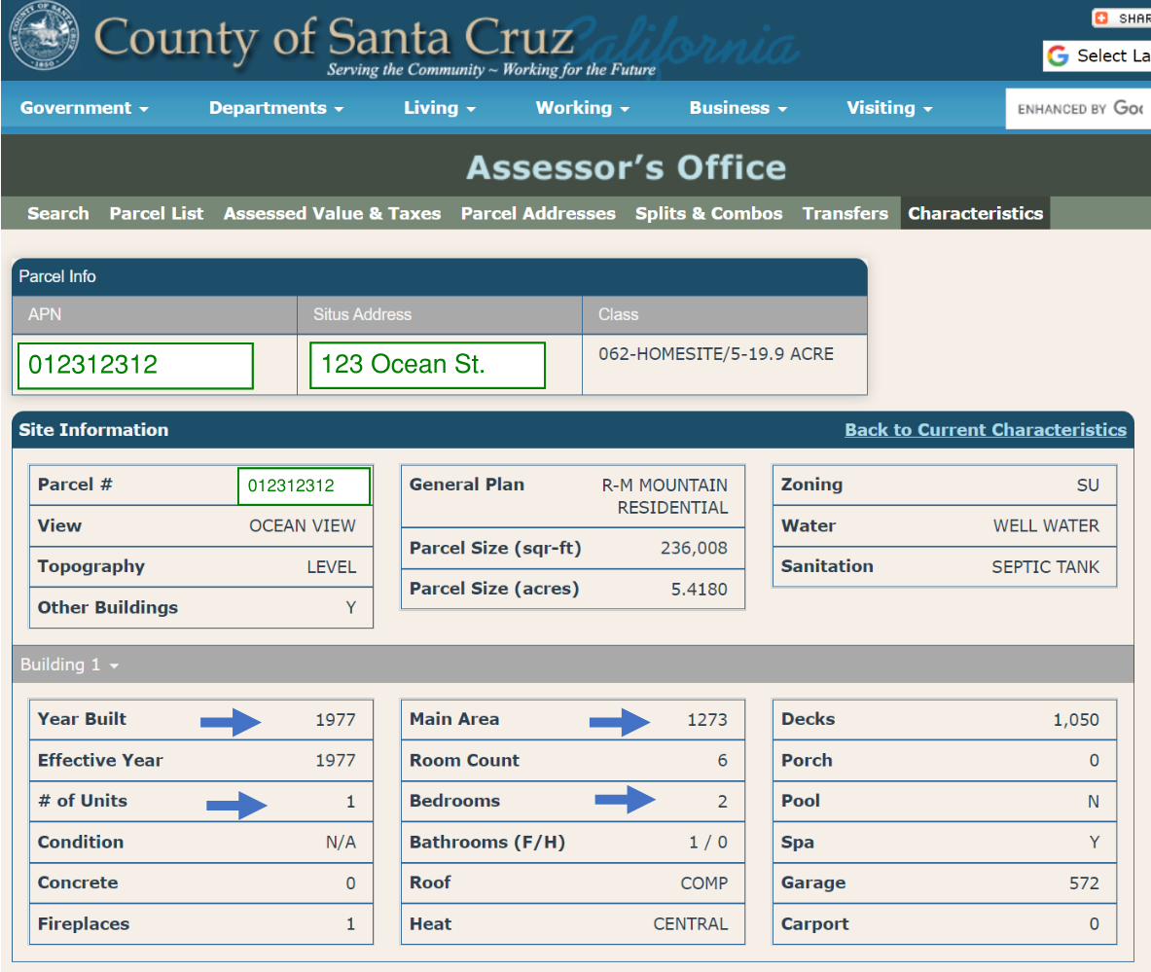
Pre-Clearance Results

Slide 21
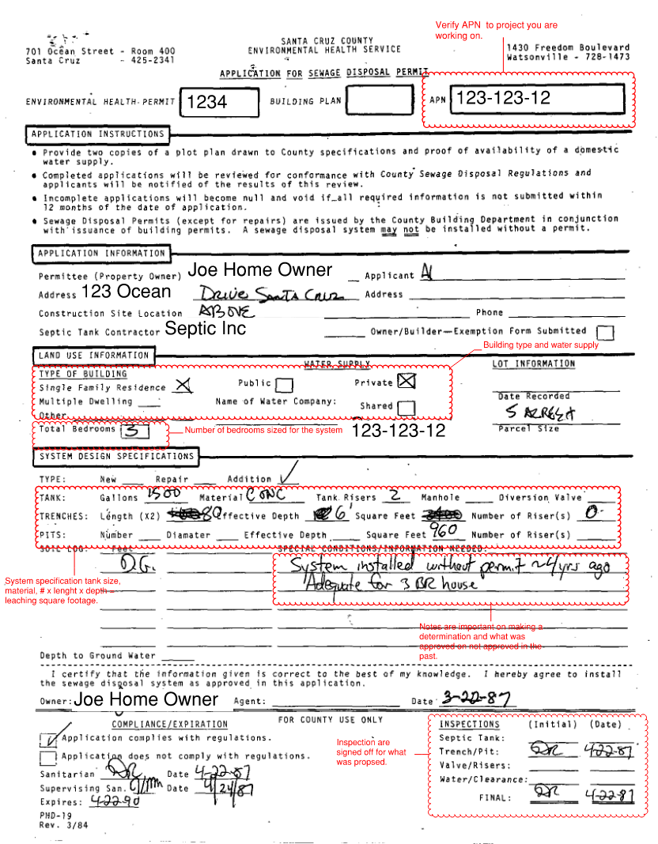
Pre-Clearance Results

Slide 22
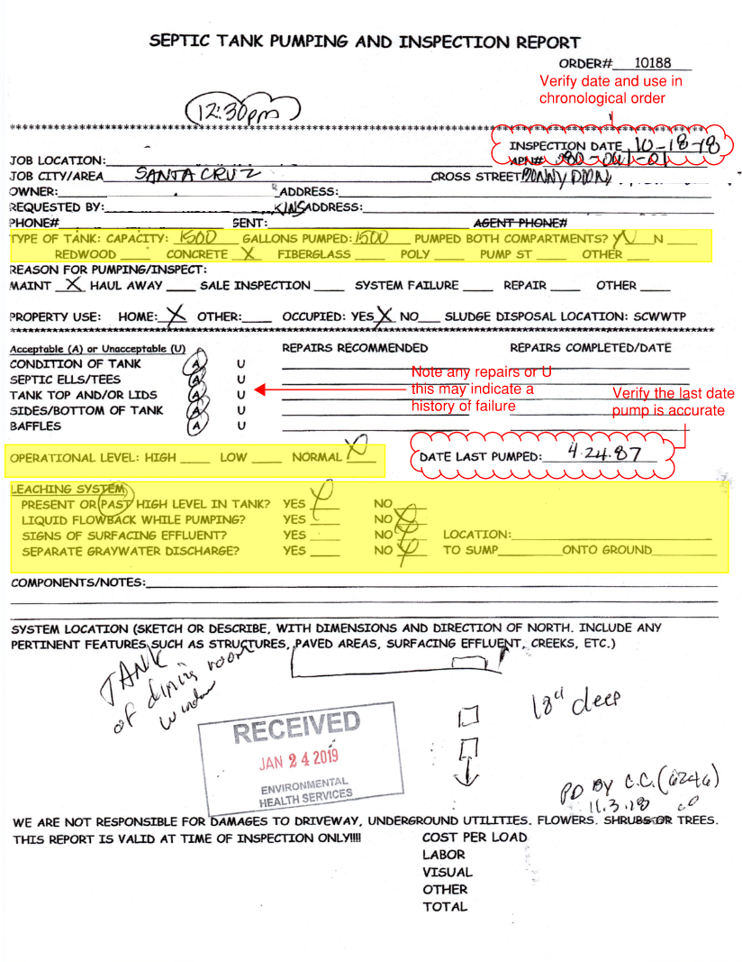
Pre-Clearance Results

Slide 23
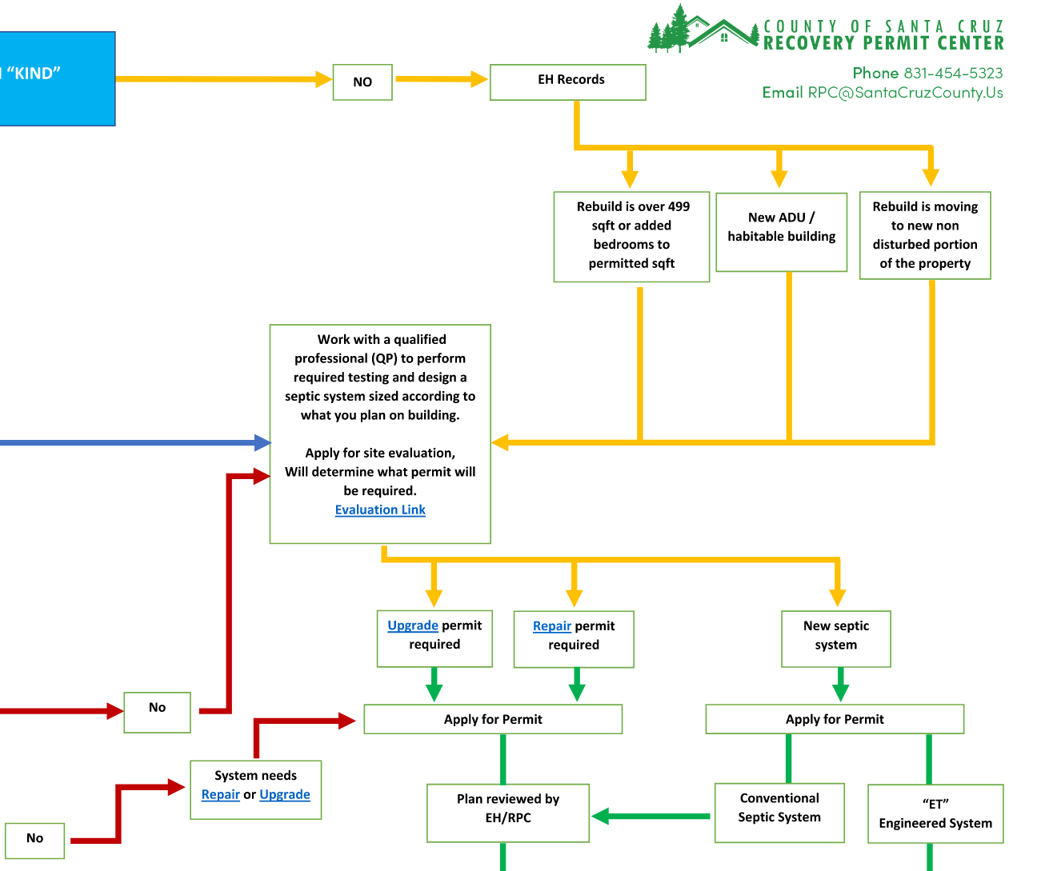
Pre-Clearance Results

Slide 24
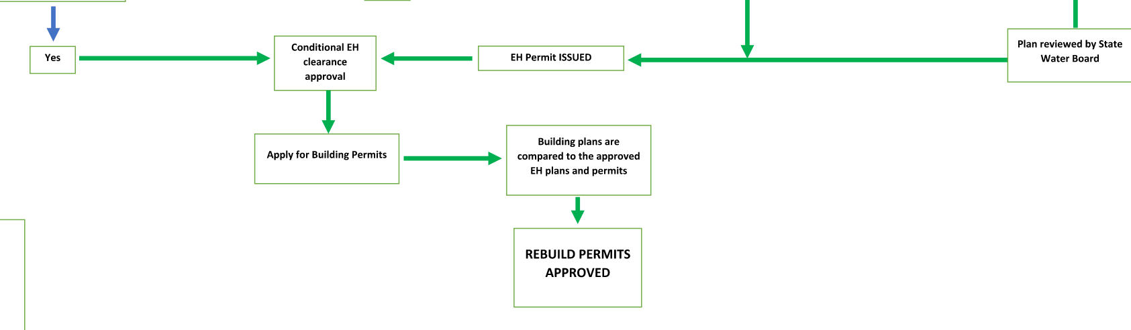
Pre-Clearance Results

Slide 25
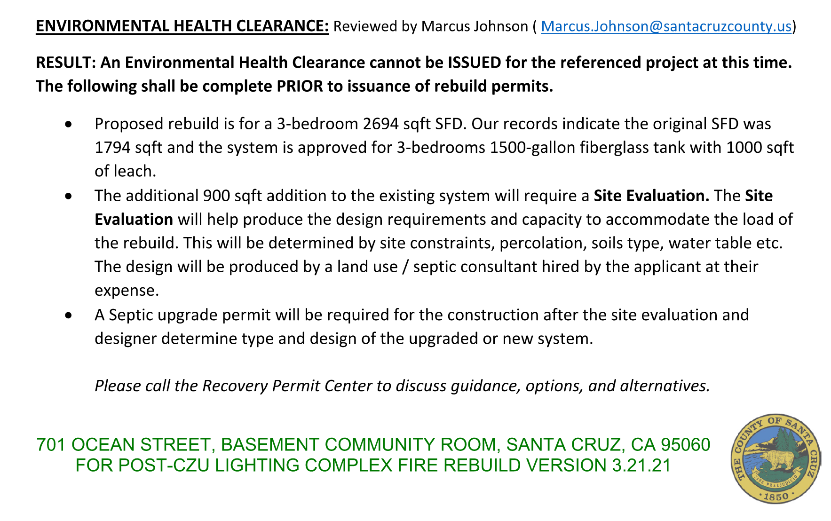
Pre-Clearance Result

Slide 26
Site Evaluation
The two primary objectives in evaluating a site are:
To ensure that the soil is permeable and will accept wastewater effluent for a long time without causing sewage to backup or surface, and,
To ensure that the wastewater is adequately treated by the soil to limit bacterial or nutrient contamination of groundwater, surface water or drinking water.
Soils that meet both objectives are permeable (coarse) enough to allow effluent to flow down through the soil horizons yet fine enough to filter or treat the effluent before reaching groundwater. To adequately treat the wastewater, the soil should be unsaturated condition. If the groundwater is too near (closer than 4') the bottom of the disposal trench, contaminants can reach the groundwater without adequate treatment. Saturated soils will also cause anaerobic conditions and chemical changes that can inhibit infiltration of effluent causing a system to surface or back up.
Site Evaluation Components
A site evaluation consists of several parts:
Assessing the physical characteristics of a parcel
Evaluating the soils
Submitting a complete report

Slide 27
LAMP
Local Area Management Plan (LAMP)
For Onsite Wastewater Treatment Systems (Septic Systems)
The Draft Local Area Management Program (LAMP) has been prepared to guide the permitting and oversight of Onsite Wastewater Treatment Systems (OWTS, also known as septic systems). This LAMP is produced in accordance with requirements set forth by the State Water Resources Control Board (State Board) in the State OWTS Policy (2013) for County permitting of OWTS.
The purpose of the LAMP is to provide for the continued use of OWTS in Santa Cruz County while providing protection of water quality and public health. Due to historical development patterns, local climate, geology and soils, a majority of the 27,700 existing OWTS could not meet the State Tier 1 Standards for Low Risk systems. However, with appropriate standards and management approaches, systems can be upgraded and utilized to continue to meet housing needs, recharge groundwater basins, and protect water quality. The LAMP is an expansion, refinement, and update of successful wastewater management approaches conducted by Santa Cruz County since 1985.

Slide 28
Permits
  Application for Sewage Disposal Permit
  Sewage Disposal Technical Information Checklist
  Sewage Disposal Application Checklist
  Site Plan Requirements
  Major : Are repairs made that consists of repairs to the leach fields.
    Replacement/Repair of leach line, whole or segment, within existing trench
    Replacement/Repair of dispersal chamber, whole or segment, within existing chamber trench
    Repair of Pretreatment Unit
  Minor : Repairs to the system components.
    Risers
    Sanitary Tees
    Effluent Filters
    Diversion Valves
    Distribution Box
    Sewer Line from House to Septic Tank
    Sewer Line from Tank to D-Box
    Solid Sewer Line Connecting D-Boxes
  Tank Only (Replacement of damage tanks body)

Slide 29
Permits
New Systems
  Standard System are submitted and reviewed through the RPC. Working with the designer and applicant to submit a complete package that meets the design parameters from the site evaluation.
  Application for Sewage Disposal Permit
  Sewage Disposal Technical Information Checklist
  Sewage Disposal Application Checklist
  Site Plan Requirements
    Specification of proposed Components
    Percolation Data
    Soils Profile

Slide 30
Permits
New Systems
  Enhanced Treatment System are submitted to the state water board for review. The reviews are done by the state, but the RPC will help facilitate a complete package that will help review.
    Plans
      Percolation Data
      Soils Profile
      Specification of proposed components
    Form 200(10/97) Application/Report of Water Discharge
    State Owner-Agent Form

Slide 31
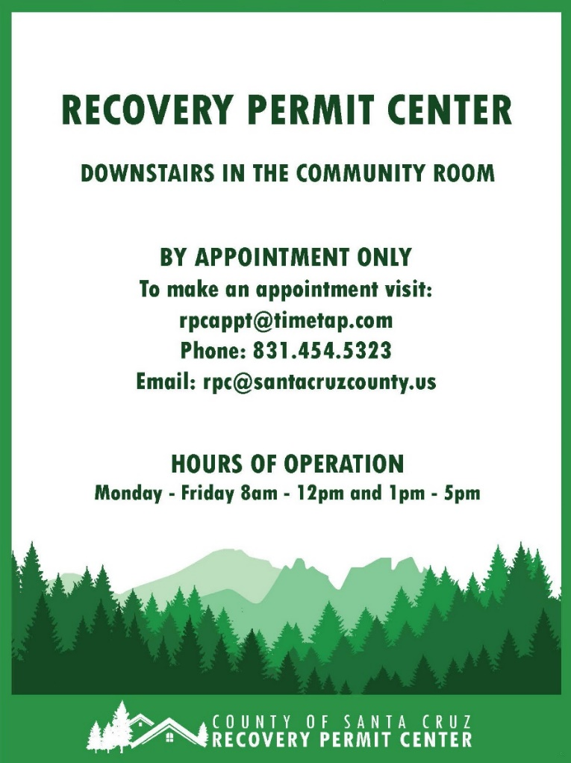
QUESTIONS/COMMENTS?

